Slide 1
Analyzing NYC Sports Trends (2017–2021)
Exploring COVID-19's Impact on Recreational Participation

Slide 2
Dataset Overview
• NYC Summer Sports Participation
• Covers 2017 to 2021
• Tracks park, sport, borough, date, and daily attendance
Notes:
This dataset captures weekly attendance for a wide variety of sports in NYC parks. It is crucial for analyzing pre- and post-COVID trends in recreational behavior.

Slide 3

Project Goals & Questions
Q1: Which team sports with high attendance rates saw the steepest decline in participation following the COVID-19 pandemic, and how might the nature of these sports contribute to this decrease? Hypothesis: Team sports that involve significant physical contact, like basketball and soccer, experienced a drop in participation after the pandemic due to concerns about health risks and the need for social distancing.
Notes:
These questions aim to uncover behavioral trends. They help us understand what types of sports were more resilient or favored during pandemic recovery.

Slide 4
Project Goals & Questions
Q2: Which sports became increasingly popular in the wake of the Covid-19 pandemic, and do they share characteristics such as being outdoor activities, individual-focused, or conducive to social distancing? Hypothesis: Sports that are individual-based, take place outdoors, and allow for effective social distancing—such as tennis, track, and frisbee—saw a rise in popularity after the pandemic, aligning with public health guidelines.
Notes:
These questions aim to uncover behavioral trends. They help us understand what types of sports were more resilient or favored during pandemic recovery.

Slide 5
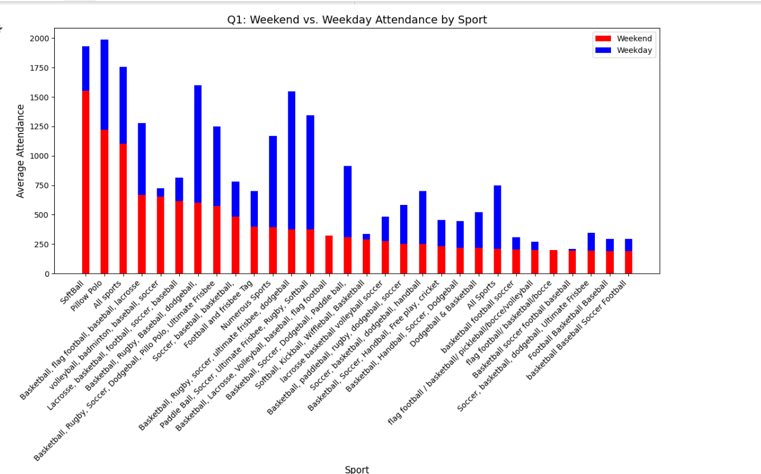
Visualizations for Q1
Stacked Bar Chart (Weekday vs Weekend):
Notes:
Stacked bars visualize attendance context (weekend vs weekday). Multi-line shows decline over years. Interactive bar chart highlights sharp drop in team sports like Basketball and Football.

Slide 6
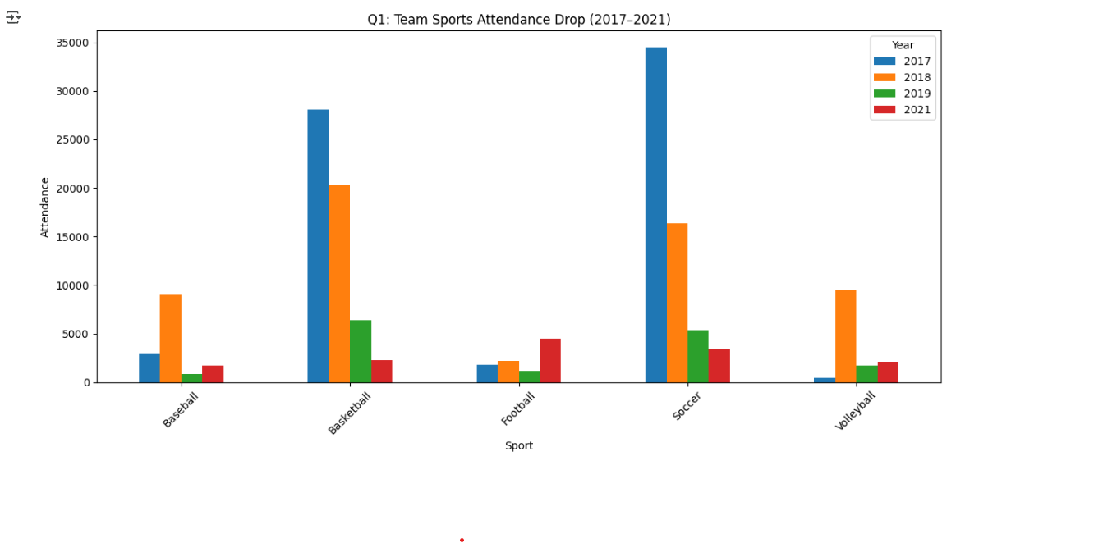
Visualizations for Q1
Multi-line Bar Chart for Team Sports:
Notes:
Stacked bars visualize attendance context (weekend vs weekday). Multi-line shows decline over years. Interactive bar chart highlights sharp drop in team sports like Basketball and Football.

Slide 7
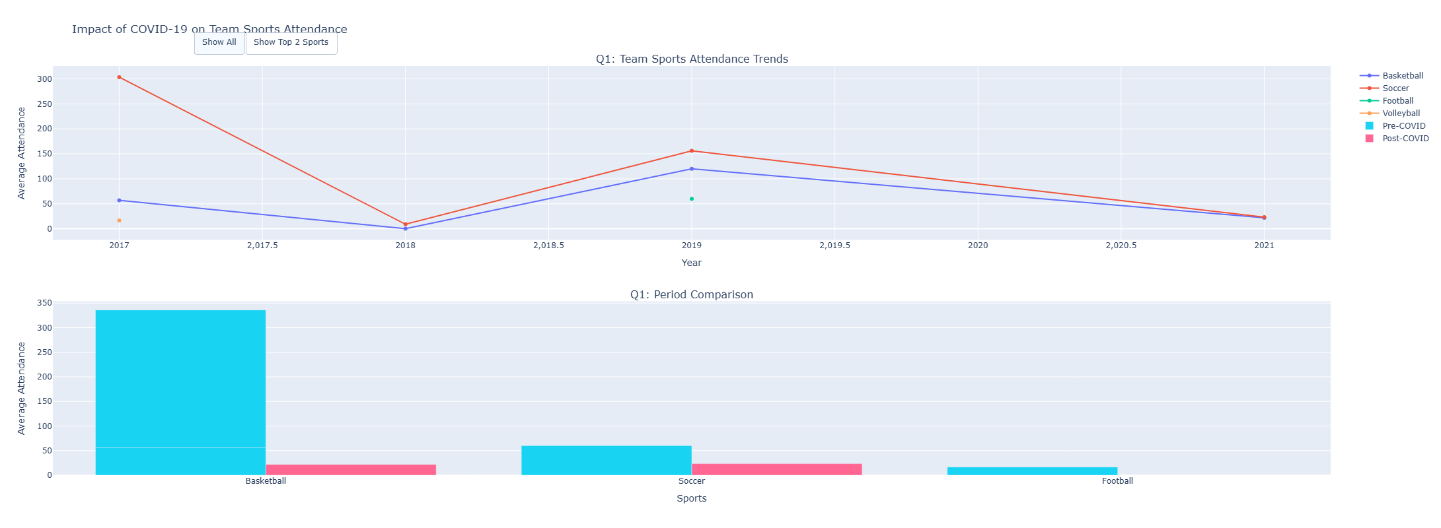
Interactive Visualization - Q1
Multi-panel chart (Plotly)
Filters by sport & compares time segments
Notes:
This interactive chart was a highlight. It separates Pre- and Post-COVID attendance using animation and interactivity. Implementing interactivity required syncing traces and updating axis dynamically.

Slide 8
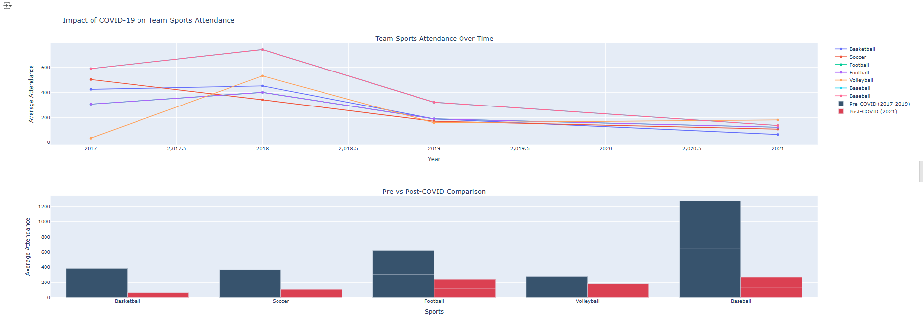
Interactive Visualization - Q1
• Filters by sport & compares time segments
Notes:
This interactive chart was a highlight. It separates Pre- and Post-COVID attendance using animation and interactivity. Implementing interactivity required syncing traces and updating axis dynamically.

Slide 9
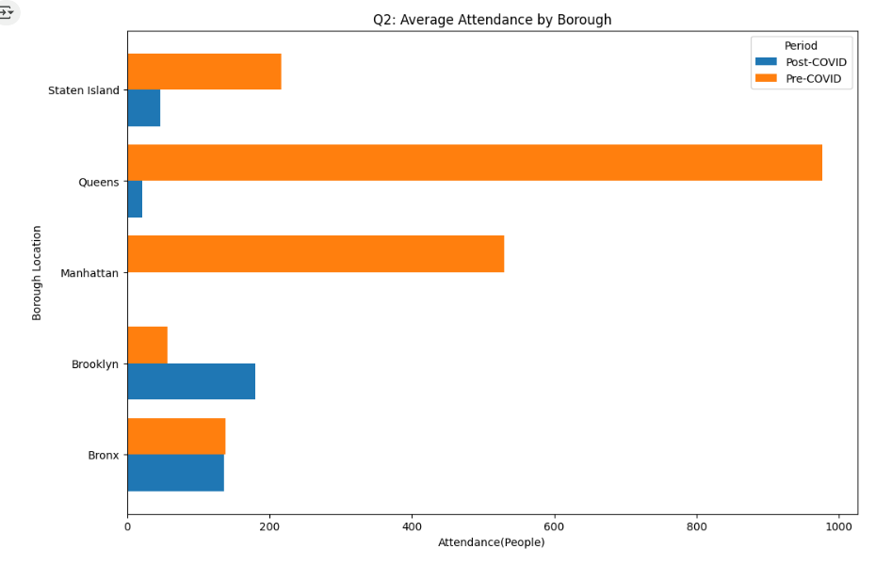
Q2 - Emerging Popular Sports
Bar Chart - Top Post-COVID Gainers
Notes:
These visualizations reveal sports like Tennis, Running, and Yoga grew in popularity. They are individual, socially distanced, and mostly outdoors—highlighting pandemic-influenced preferences.

Slide 10
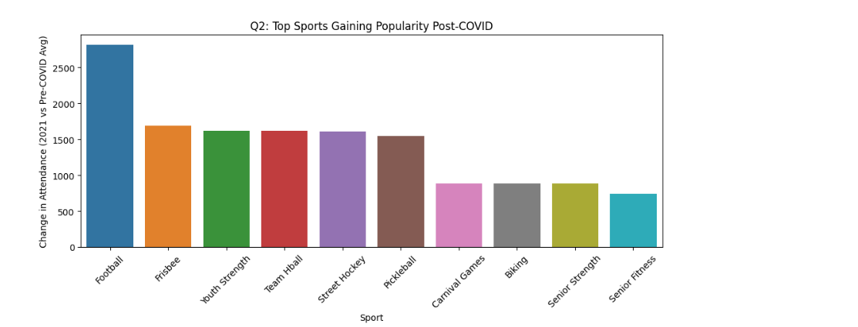
Q2 - Emerging Popular Sports
Bar Chart - Top Post-COVID Gainers:
Notes:
These visualizations reveal sports like Tennis, Running, and Yoga grew in popularity. They are individual, socially distanced, and mostly outdoors—highlighting pandemic-influenced preferences.

Slide 11
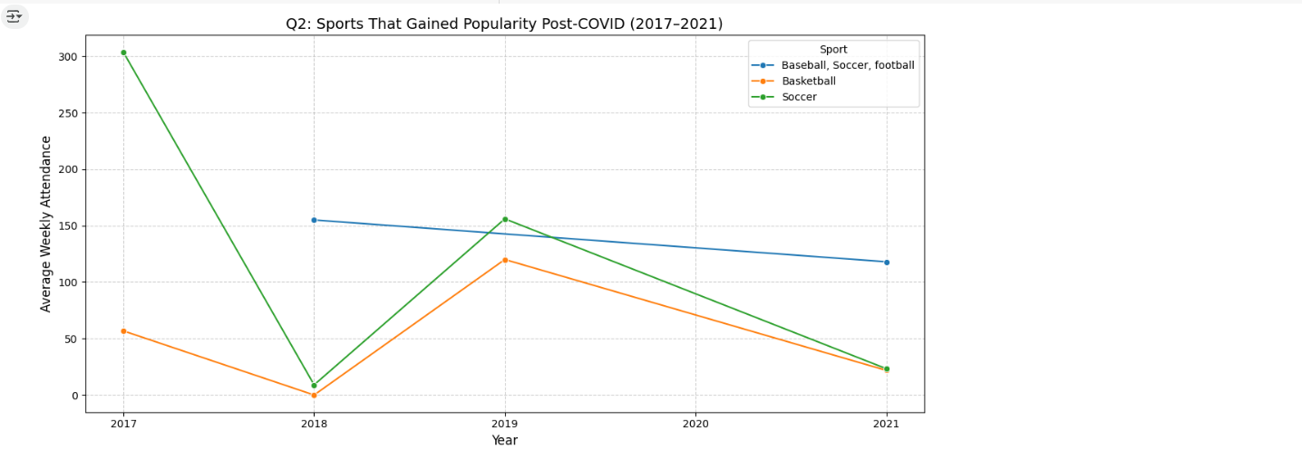
Q2 - Emerging Popular Sports
Multi-line Yearly Growth:
Notes:
These visualizations reveal sports like Tennis, Running, and Yoga grew in popularity. They are individual, socially distanced, and mostly outdoors—highlighting pandemic-influenced preferences.

Slide 12
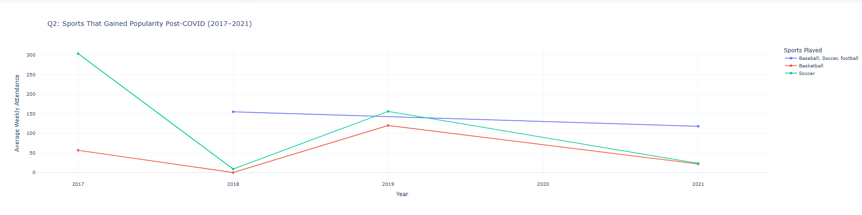
Interactive Visualization – Q2
panel chart (Plotly)
Multi-line Yearly Growth

Slide 13

Data Cleaning Challenges
Inconsistent sport name formatting
Multiple sports in one row
Duplicates and missing values
Notes:
Cleaning was one of the hardest parts. I built a regex parser to normalize sport names and split them correctly. Grouping and exploding sports helped create accurate time-series analyses.

Slide 14
Conclusion
• Team sports declined post-2020
• Outdoor/solo sports became popular
• Q2 visualizations provided richer insights
Notes:
While both questions were insightful, Q2 revealed long-term preference shifts. Implementing interactive visual idioms helped communicate the trends more effectively.

Slide 15
Thank You!
Presented by: Aamr Ibrahim
Contact: aibra007@odu.edu
Notes:
Thanks for your time! Let me know if you have any questions about the data, process, or findings.

